Slide 1

CSE101-Lec#21
Some other functions from string handling library

Slide 2
Outline
String Conversion Functions
Character arithmetic
Sorting of strings.

Slide 3
String Conversion Functions
String Conversion functions
In <stdlib.h> (general utilities library)
Convert strings of digits to integer and floating-point values
Function prototype | Function description
double atof( const char *nPtr ); | Converts the string nPtr to double.
int atoi( const char *nPtr ); | Converts the string nPtr to int.
long atol( const char *nPtr ); | Converts the string nPtr to long int.
double strtod( const char *nPtr, char **endPtr ); | Converts the string nPtr to double.
long strtol( const char *nPtr, char **endPtr, int base ); | Converts the string nPtr to long.
unsigned long strtoul( const char *nPtr, char **endPtr, int base ); | Converts the string nPtr to unsigned long.

Slide 4
atof()
Function atof
Function atof converts its argument—a string that represents a floating-point number—to a double value.
The function returns the double value.
If the converted value cannot be represented—for example, if the first character of the string is a letter—the behavior of function atof is undefined.

Slide 5
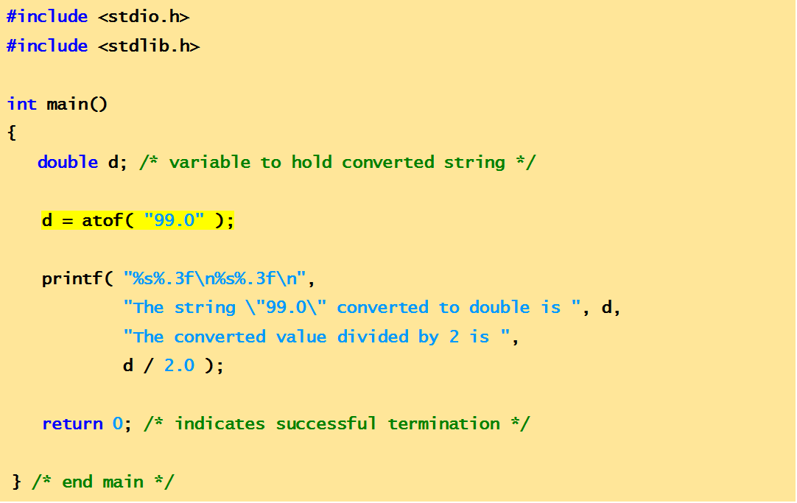
Example Code
This program demonstrates string conversion function: atof()
The string "99.0" converted to double is 99.000
The converted value divided by 2 is 49.500
output

Slide 6
atoi()
Function atoi
Function atoi converts its argument—a string of digits that represents an integer— to an int value.
The function returns the int value.
If the converted value cannot be represented, the behavior of function atoi is undefined.

Slide 7
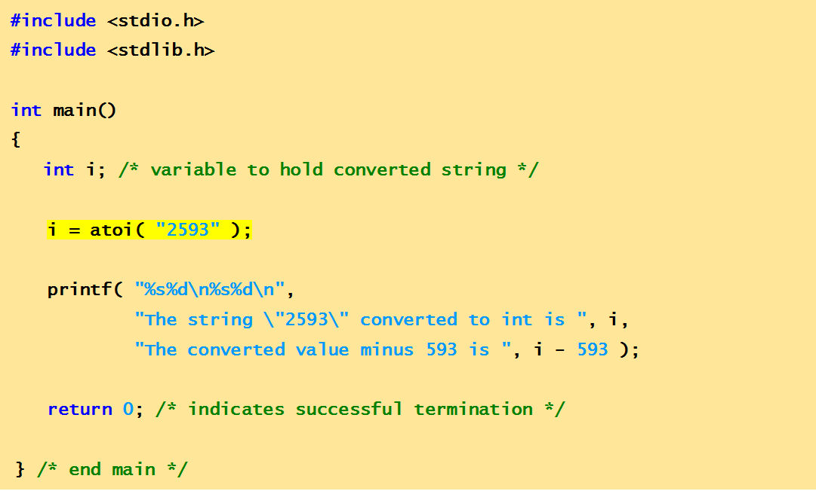
Example Code
This program demonstrates string conversion function: atoi()
The string "2593" converted to int is 2593
The converted value minus 593 is 2000
output

Slide 8
atol()
Function atol
Function atol converts its argument—a string of digits representing a long integer— to a long value.
The function returns the long value.
If the converted value cannot be represented, the behavior of function atol is undefined.
If int and long are both stored in 4 bytes, function atoi and function atol work identically.

Slide 9
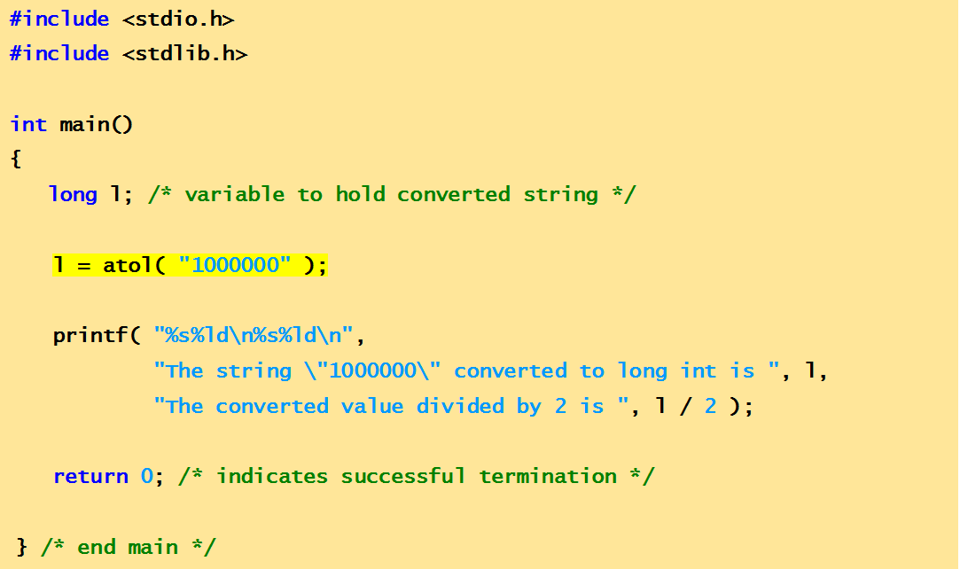
Example Code
This program demonstrates string conversion function: atol()
The string "1000000" converted to long int is 1000000
The converted value divided by 2 is 500000
output

Slide 10
strtol()
Function strtol converts to long a sequence of characters representing an integer.
The function receives three arguments—a string (char *), a pointer to a string and an integer.
The string contains the character sequence to be converted.
The pointer is assigned the location of the first character after the converted portion of the string.
The integer specifies the base of the value being converted(octal, decimal or hexadecimal format).

Slide 11
#include <stdio.h>
#include <stdlib.h>
int main( void )
{
const char *string = "-1234567abc"; /* initialize string pointer */
char *remainderPtr; /* create char pointer */
long x; /* variable to hold converted sequence */
x = strtol( string, &remainderPtr, 0 );
printf( "%s\"%s\"\n%s%ld\n%s\"%s\"\n%s%ld\n",
"The original string is ", string,
"The converted value is ", x,
"The remainder of the original string is ",
remainderPtr,
"The converted value plus 567 is ", x + 567 );
return 0;
} /* end
This program demonstrates string conversion function: strtol()
The original string is "-1234567abc"
The converted value is -1234567
The remainder of the original string is "abc"
The converted value plus 567 is -1234000

Slide 12
strstr
Function strstr <string.h>
char *strstr(const char *s1, const char *s2);
Function strstr searches for the first occurrence of its second string argument in its first string argument.
If the second string is found in the first string, a pointer to the location of the string in the first string argument is returned.
Otherwise, a NULL pointer is returned

Slide 13
#include <stdio.h>
#include <string.h>
int main( void )
{
const char *string1 = "abcdefabcdef"; /* string to search */
const char *string2 = "def"; /* string to search for */
printf( "%s%s \n%s%s\ n\n %s\ n %s%s\n",
"string1 = ", string1, "string2 = ", string2, "The remainder of string1 beginning with the", "first occurrence of string2 is:", strstr(string1, string2));
} /* end main */
Program searches for the first occurrence of string2 in string1.
string1 = abcdefabcdef
string2 = def
The remainder of string1 beginning with the
first occurrence of string2 is: defabcdef

Slide 14
Character arithmetic
To perform increment , decrement, addition subtraction operations on the characters.
These operations work on the ASCII value of characters.
Starting from ASCII value of ‘a’ = 97 to the ASCII value of ‘z’ = 122

Slide 15
Increment
To display next char value
void main()
{
char x = 'a' + 1;
printf("%c", x); // Display Result = 'b‘
printf("%c", ++x); // Display Result = ‘c‘
}

Slide 16
Decrement
To display previous char value
void main()
{
char x = ‘b' - 1;
printf("%c", x); // Display Result = ‘a‘
}

Slide 17
Addition
Adding two ASCII values
void main()
{
char x = 'a‘ + ‘c’;
printf("%c", x); /* Display Result = - ( addition of ASCII of a and c is 196) */
}

Slide 18

Subtraction
Adding two ASCII values
void main()
{
char x = ‘z’ – ‘a’;
printf("%c",x); /* Display Result = ↓ (difference between ASCII of z and a ) */
}
Quick yak:
The friendship game can NOW be made more comprehensive based on ASCII values of characters in the First Names

Slide 19
Sorting of strings
To sort the strings in increasing order.
That is if list of names is given then sort the list in alphabetical order.
Use strcmp() and strcpy() functions.

Slide 20
#include<stdio.h>
#include<conio.h>
#include<string.h>
main()
{
char name[20][20];
char temp[20];
int i,j,n,l;
printf("Enter the no. of string to be sorted");
scanf("%d",&n);
printf(“Enter %d strings:\n", n);
for(i=0;i<=n;i++)
gets(name[i]);
for(i=0;i<=n;i++)
{
for(j=i+1;j<=n;j++)
{
l = strcmp(name[i], name[j]);
if(l>0) // if first string is greater then swap
{
strcpy(temp, name[i]);
strcpy(name[i],name[j]);
strcpy(name[j],temp);
}
}
}
puts("Sorted list is:\n");
for(i=0;i<=n;i++)
puts(name[i]);
getch();
}
Program to sort the strings using arrays.

Slide 21
Enter the no. of string to be sorted 3
Enter 3 strings
lovely
aananya
aman preet
Sorted list is:
aananya
aman preet
lovely

Slide 22
Next Lecture
Marking the attendance of students by passing attendance sheet …??
Pointer

